Slide 1
Classification
Part 1: Logistic Regression & NN
Rutgers Cognitive Science Club
Rutgers Statistics Club

Slide 2
A Review Of Linear Regression
ŷ is a prediction of the linear relationship between k independent variables (also called features) and a dependent variable (target)
This prediction is quantitative- It predicts a continuous numerical quantity e.g. a person’s height, the cost of a house, city population

Slide 3
From Quantitative to Qualitative
Instead of predicting quantitative data, how do we predict data that fits into categories (ie categorical)?

Slide 4
Qualitative (Categorical) Data
Let’s say that our dependent variable now falls into two levels - (e.g. success or failure).
Examples: Given an image of an animal, can we predict whether it is a cat or a dog? Given a person’s shopping preferences, can we predict whether they are male or female?

Slide 5
Qualitative Predictions
Note that there can be more than 2 levels.
However, we will initially constrain ourselves to choosing between 2 levels (in this case cat/dog).
How do we use features (both qualitative and quantitative) to classify things into categories?

Slide 6
A Classification Problem
Let’s say we have some data on someone’s annual income, their age, and whether they studied political science in college.
Can we predict whether they are a politician?
Is it possible to use linear regression for this?

Slide 7
Identifying the Problem Structure
We can identify 3 independent variables (features) and 1 dependent variable (target):
x₁ = annual income, x₂ = age, x₃ = political science major or not
y₁ = politician or not

Slide 8
A Quick Aside on Data Manipulation
How would we use political science major or not to the regression model? It is not a quantitative variable!
We can convert this variable into what is called a dummy variable or binary variable by setting the variable to 1 if political science major and 0 if not

Slide 9
Let’s Formalize the Problem
For our features, we now have:
x₁ = age: ranges from 0 to 120(ish)
x₂ = annual income: ranges from 0 to millions (rarely 100s of millions & billions)
x₃ = was political science major: either 0 or 1
y = is a politician: either 0 or 1
Note: for all classification problems, y will always be categorical, i.e. taking on integers, each representing a class (category)

Slide 10
Based On This Formalization ...
Can we do linear regression?

Slide 11
NO! (For Most Cases)
Since linear regression will fit a continuous line:
Let’s say we have y take on 3 values: 1 for politician, 2 for lawyer, and 0 for neither.
Then if linear regression were run, we might get ŷ=1.5.
Would it be sensible to say that our person is some hybrid of lawyer and politician?

Slide 12
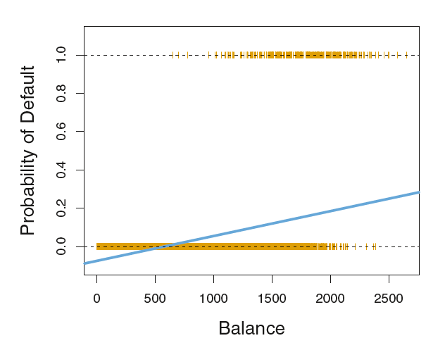
NO! cont.
In Chapter 4 of Introduction to Statistical Learning, the authors introduce a special case of where linear regression may work for classification.
But keep in mind, this is the exception and not the rule.
And even in this special case there are problems.

Slide 13
Logistic Regression
A transition from quantitative to qualitative prediction

Slide 14
Logistic Regression: A Transformation of Linear Regression
Biggest problem we need to address is forcing our prediction, ŷ, to be either a 0 or 1
Let’s try:
Convert ẑ to some value between 0 and 1 & call it p
Pick a threshold, t, such as 0.5
If p >= t, then ŷ = 1
If If p < t, then ŷ = 0

Slide 15
Linear Model
Hopefully, by now
is familiar
We only use ẑ as opposed to ŷ to denote that this is not our final prediction

Slide 16
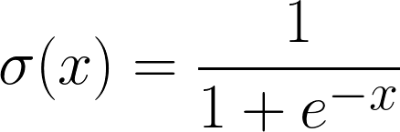
2. Introducing Logistic Function
The logistic function (often referred to as sigmoid in machine learning) has the form:

Slide 17
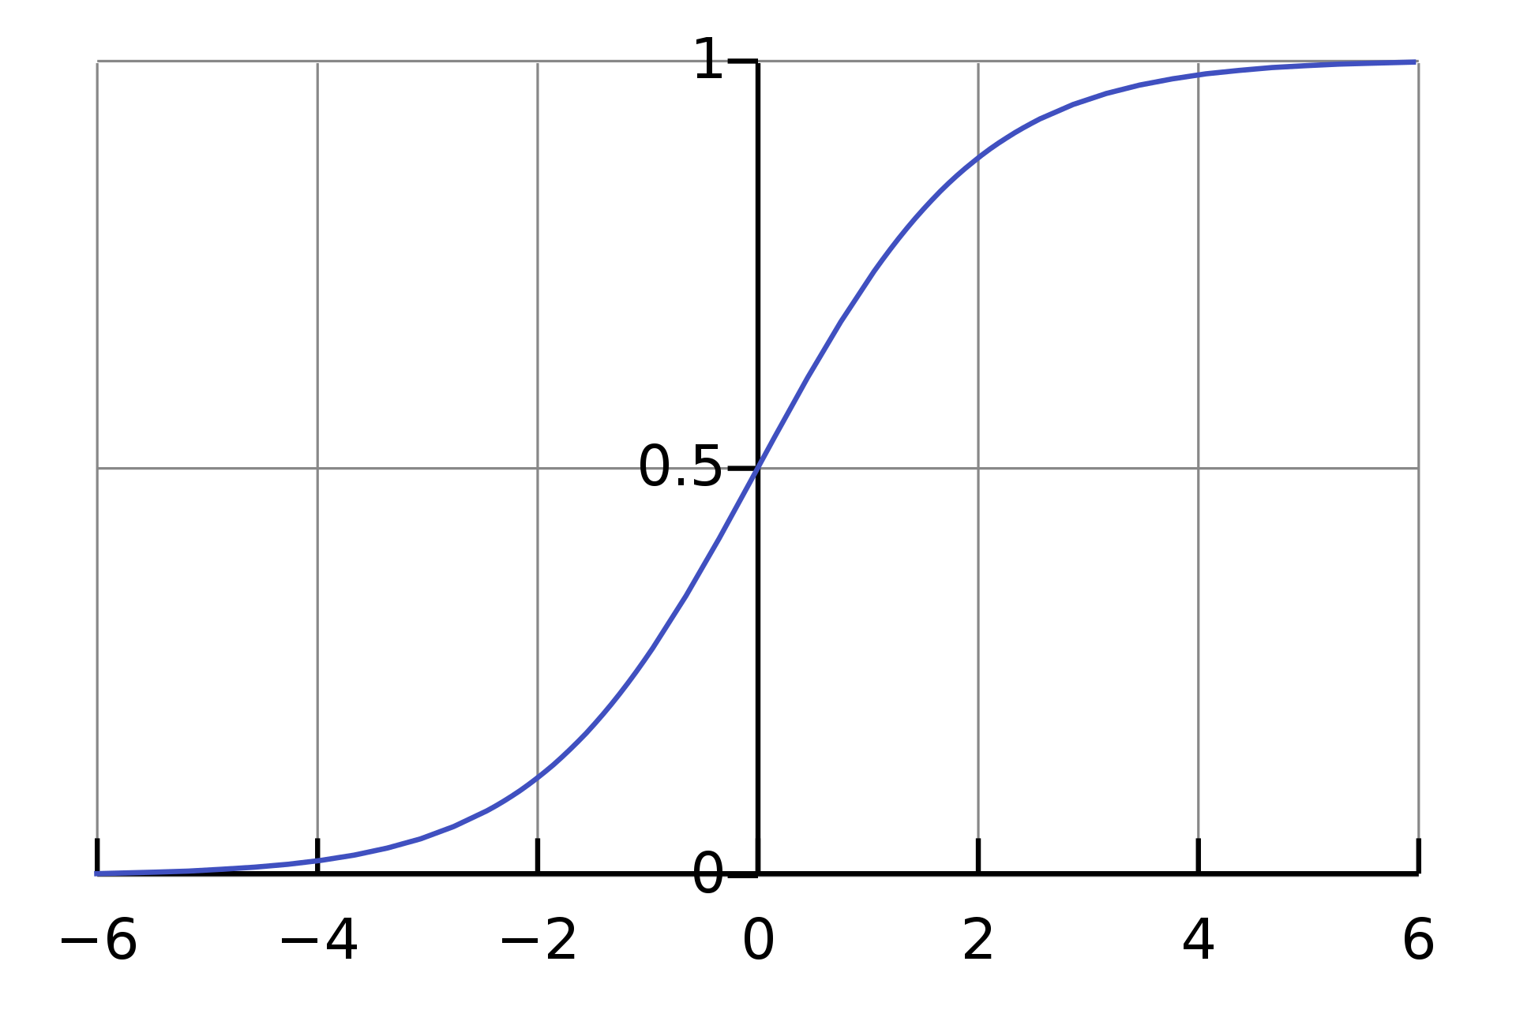
2 (cont). Logistic Function Plot

Slide 18
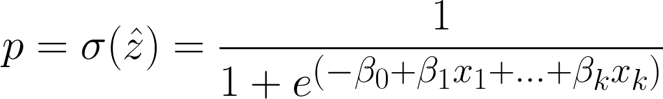
2. Applying The Logistic Function
So now, we have
So p will now be between 0 and 1. We can think of this as the probability that y is 1.

Slide 19
Aside: What Are the Odds?
Let’s say I ask the question, “What are the odds that you get an A on your next exam?”
Let’s say you tell me 1 to 3 (although I hope they’re better).
What you’re really saying is the probability, p, that I get an A on my exam is 3 times lower than the probability, (1-p), that I don’t get an A.
In an equation: p / (1-p) = 1/3

Slide 20
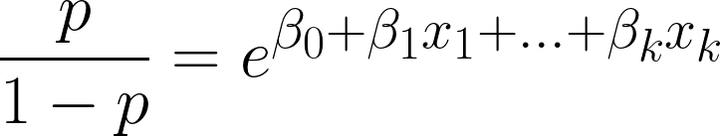
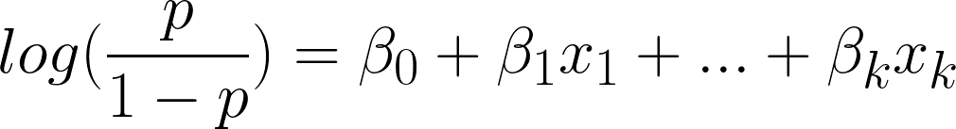
Aside cont.: What are the Log-Odds
In our case, we have the odds:
So the log-odds are:

Slide 21
So What?
What this tells us is that:
Whereas in linear regression, a unit change in x_{i} gave us a 𝛽_{i} increase in y.
Here, a unit change in x_{i} yields an e^{𝛽i} increase in the odds that y = 1.
In other words, we can also say that a unit change in x_{i} gives us a 𝛽_{i} increase in the log-odds that y = 1.

Slide 22
3. Choosing The Threshold
Normally, it makes sense to simply choose t=0.5.
However, if we are doctors, for example, and we want to avoid missing a case of cancer if someone has it (false negative or type II error), but we are okay with accidentally classifying some people without cancer as having it, we can lower t to (e.g.) 0.4
On the other hand, if we are deciding whether to give someone the death penalty or not based on the evidence of the crime, we want to avoid the possibility of classifying someone innocent as guilty (false positive or known as type I error), which allows for the possibility of mistakenly classifying someone guilty as innocent so we could raise t to 0.6 for example.

Slide 23
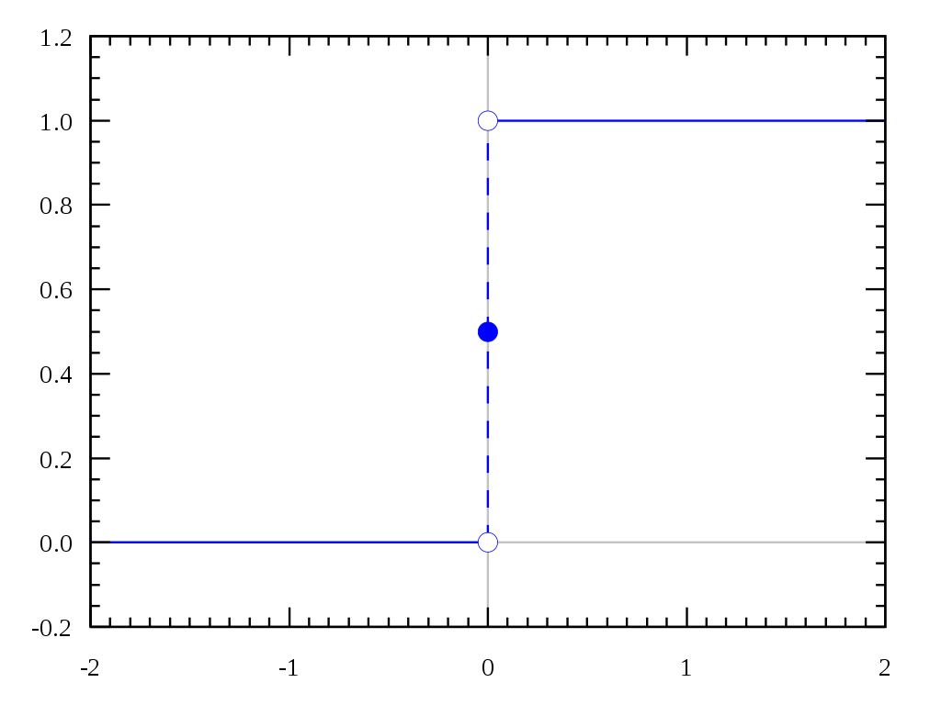
4. Applying the Threshold
Then, all that’s left is to decide our prediction ŷ, by doing
If p >= t, ŷ = 1
If p < t, ŷ = 0
Step (Threshold) Function with t = 0

Slide 24
How Do We Measure Our Cost?
Intuitively, our cost function should ensure we are maximizing the number of correct predictions given our features.
So, per datapoint, we want that our predicted value, ŷ, match y.
So we need the chances that ŷ = y given all our x_{i}’s.
Also, we normally take the log of this, for similar reasons as to why we talk about log-odds

Slide 25
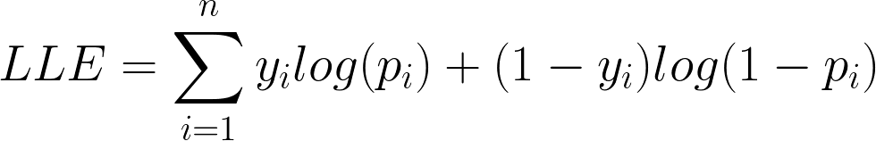
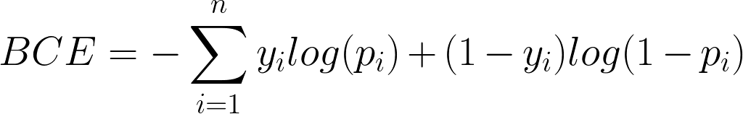
Maximum Likelihood & Cross Entropy
We want to maximize the log-likelihood over all data points and so here we are actually maximizing the opposite of cost (which we will call gain)
We can also minimize the negative of log-likelihood to turn it into a cost function. This cost function is called binary cross entropy.

Slide 26
In Practice
In practice, the way we do this is train our model, by feeding it data points one by one
Then, for each datapoint, we compute (if we are using BCE):
This tells us the error per datapoint. Then, we use something called gradient descent to modify our 𝛽_{i}’s so that next time around we may correctly classify the point if we didn’t this time

Slide 27
A Visual Representation

Slide 28
Multiple Linear Regression
x₁
𝛽₁
𝛽₂
x₂
...
ŷ
𝛽_{k}
x_{k}

Slide 29


Logistic Regression
x₁
𝛽₁
𝛽₂
x₂
...
ŷ
t
𝛽_{k}
p
x_{k}

Slide 30
Logistic Regression (Relabeled)
x₁
w₁
w₂
x₂
...
ŷ
t
w_{k}
p
x_{k}

Slide 31
Single Layer Neural Network
x₁
w₁
w₂
x₂
...
ŷ
t
w_{k}
p
x_{k}

Slide 32
The Terminology of Neural Networks
What terminology stays the same?
Features (independent variable), target (dependent variable)

Slide 33
The Terminology of Neural Networks
What changes: Neurons and Layers:
Every location where we can store separate information i.e. the feature values, intermediate values, and prediction values are each referred to as neurons.
We now group things into layers: the feature neurons collectively make up the input layer. The prediction neurons collectively make up the output layer. We can also add neurons in between these two layers for intermediate processing steps. These are called hidden layers.

Slide 34
The Terminology of Neural Networks
What changes: Weights and Activation Functions:
The coefficients that relate the value of each neuron in one layer to the neurons of the subsequent layers are called weights and they are often denoted w_{j,i} indicating the connection between source neuron i and destination neuron j
The logistic or sigmoid function from before is one type of activation function.
Activation functions let us put all the outputs of neurons on the same scale and also introduce nonlinearities

Slide 35
Aside: Nonlinearity
If we look at one of the benefits of applying the logistic function to our inputs, it is that we can move beyond predicting linear relationships in our data.
The logistic function provides a way to model some sort of nonlinear relationship (converting our feature input to a prediction of its category)
Chaining many of these nonlinear relationships one on top of the other allows us to model arbitrarily complicated phenomena

Slide 36

The “Anatomy” of a Neuron
Outgoing Weight
Activation Function
w_{i,a}
w_{d,i}
Incoming Weight
w_{i,b}
w_{e,i}
w_{i,c}
w_{f,i}
Weighted Input to Neuron i
Weighted Output From Neuron i
Neuron i

Slide 37
Neural Network With 1 Hidden Layer
w_{1,1}
h₁
x₁
h₂
x₂
...
...
ŷ
w_{j,i}
x_{k}
w_{a,k}
h_{a}
Input Layer
Hidden Layers
Output Layer

Slide 38
Neural Network With 1 Hidden Layer
h₁
x₁
h₂
x₂
...
...
ŷ
x_{k}
h_{a}
Input Layer
Hidden Layers
Output Layer

Slide 39
Neural Network With 1 Hidden Layer
h₁
x₁
h₂
x₂
...
...
ŷ
x_{k}
h_{a}
Input Layer
Hidden Layers
Output Layer

Slide 40
Neural Network With 1 Hidden Layer
h₁
x₁
h₂
x₂
...
...
ŷ
x_{k}
h_{a}
Input Layer
Hidden Layers
Output Layer

Slide 41
Generalized Neural Network
h₁
h_{m}
x₁
h₂
h_{m+1}
x₂
...
...
...
...
ŷ
x_{k}
h_{a}
h_{m+d}
Input Layer
Hidden Layers
Output Layer

Slide 42
What’s Left to Address
How do we actually train neural networks?
Gradient descent
Backpropagation
What is the utility of different activation functions?
The importance of regularization for neural networks
How to move to more than 2 categories for our prediction
A short look at commonly used models:
Convolutional Neural Networks
Recurrent Neural Networks

Slide 43


Likelihood Estimate (In Detail)
For a given datapoint i:
The probability that we correctly predict y_{i} to be 1 when y_{i} is actually 1 is
The probability that we correctly predict y_{i} to be 0 when y_{i} is actually 0 is
This makes sense because if y_{i} is 1, then we will get out p_{i} and if it is 0, we will get out 1-p_{i}.
The other factor will always be 1 & this is useful.

Slide 44
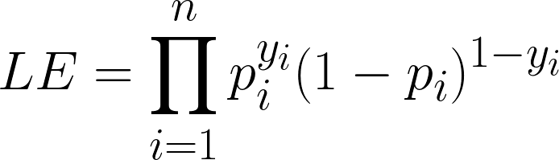
Likelihood Estimate cont.
So our total likelihood estimate is
Taking the log of this, we get the log-likelihood:

